Slide 1


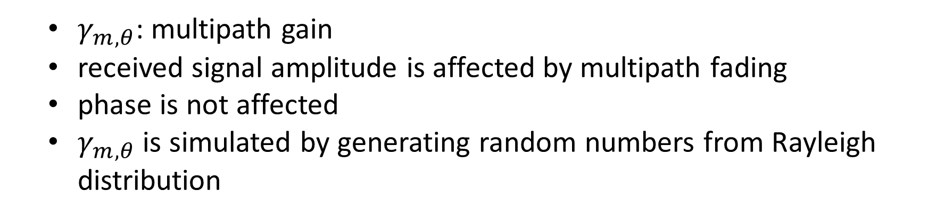
Unknown Flat Fading
$γ_{m,θ}$: multipath gain
received signal amplitude is affected by multipath fading
phase is not affected
$γ_{m,θ}$ is simulated by generating random numbers from Rayleigh distribution

Slide 2
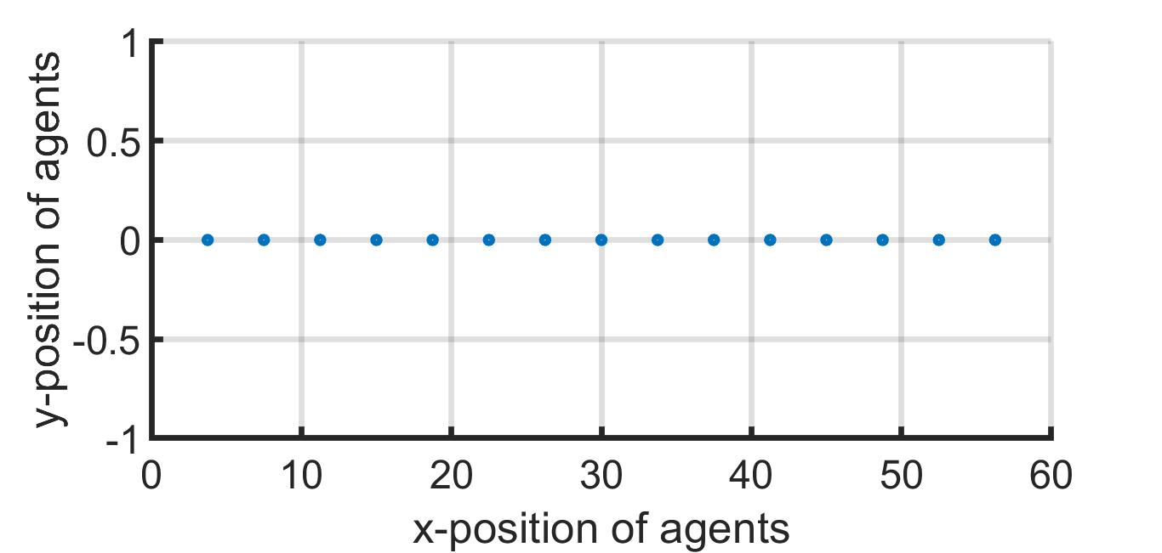
1-D Array

Slide 3
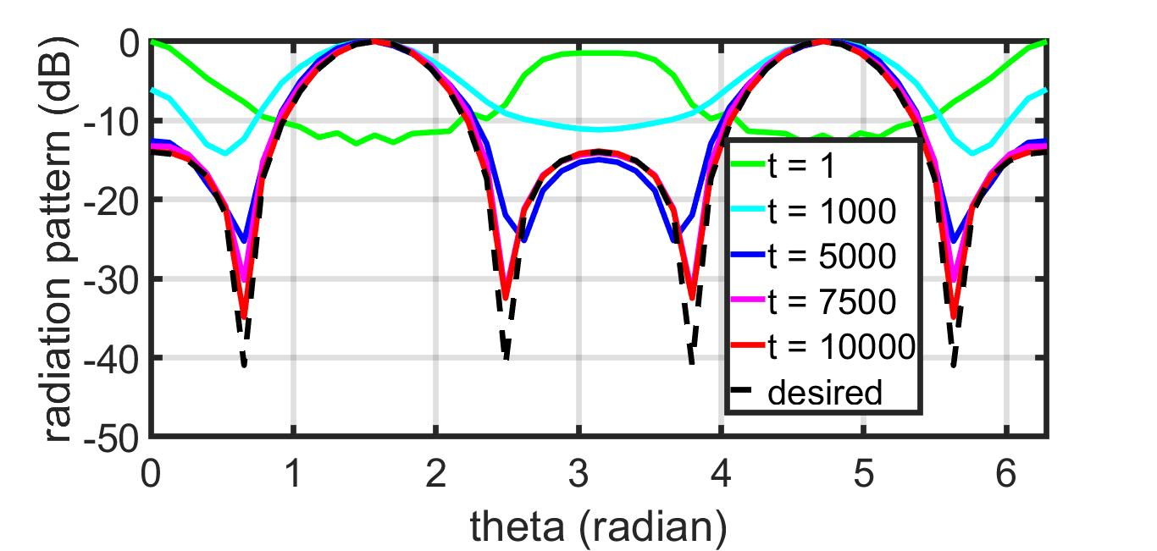
Radiation Pattern: IPG – 1-D Array

Slide 4
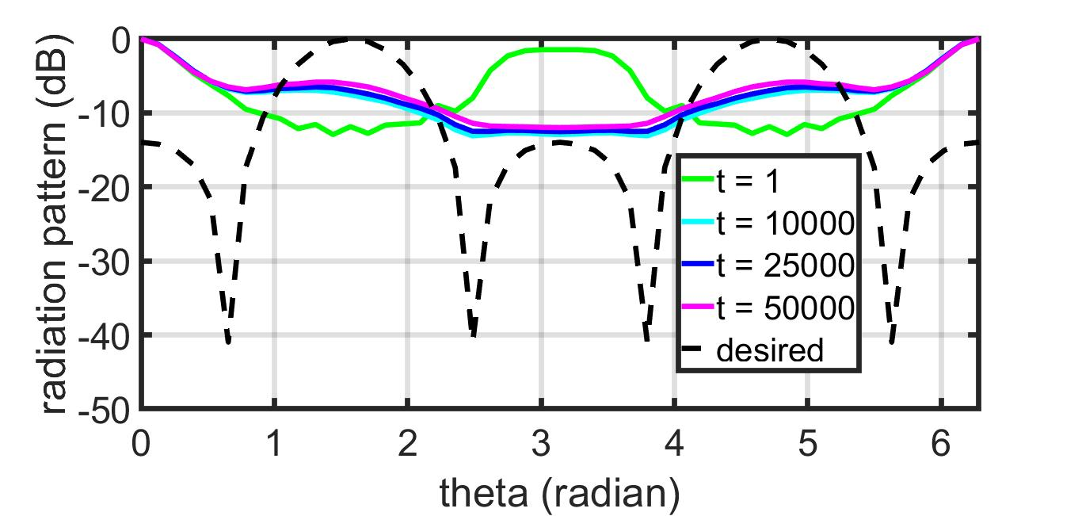
Radiation Pattern: GD – 1-D Array

Slide 5
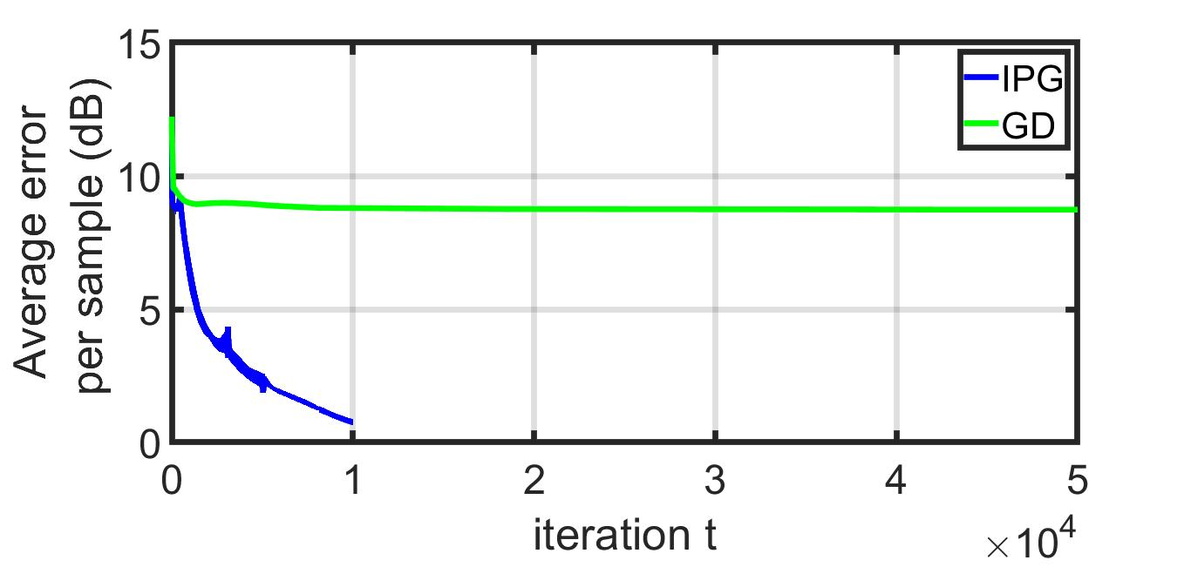
Error ~ Iteration: 1-D Array

Slide 6
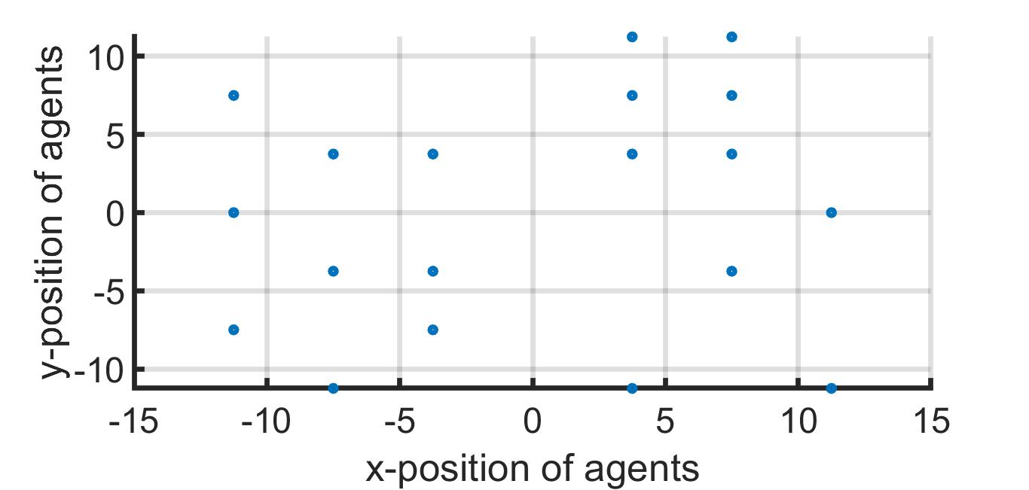
2-D Array

Slide 7
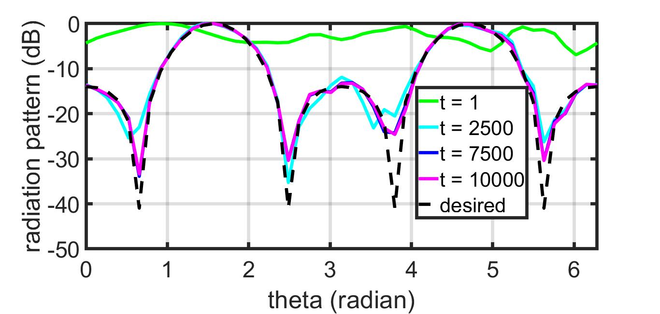
Radiation Pattern: IPG – 2-D Array

Slide 8
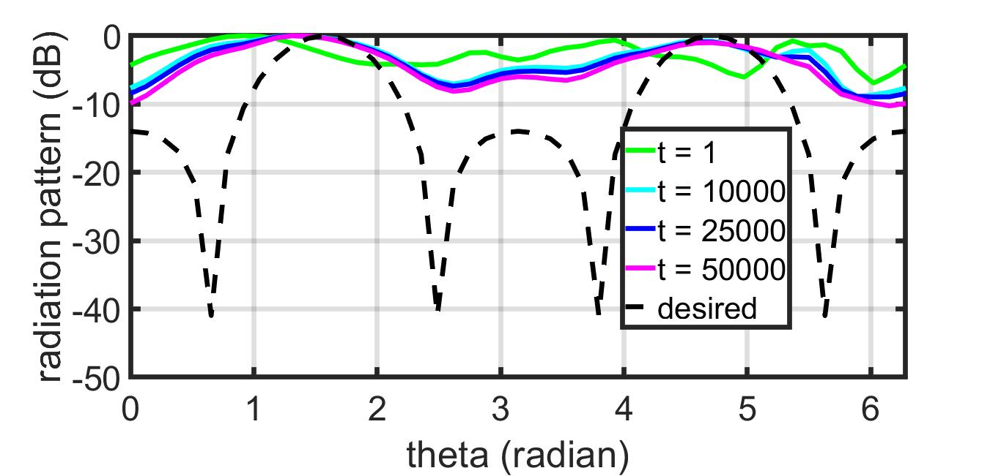
Radiation Pattern: GD – 2-D Array

Slide 9
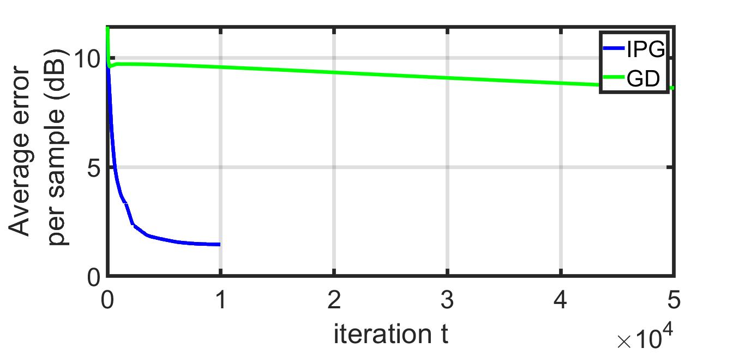
Error ~ Iteration: 2-D Array

